Slide 1
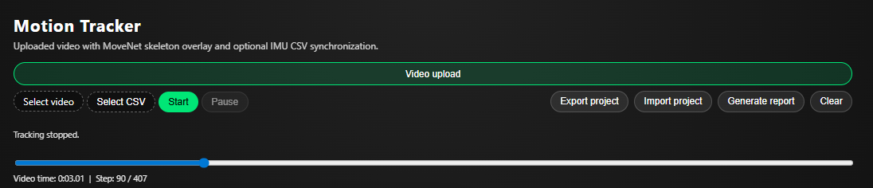
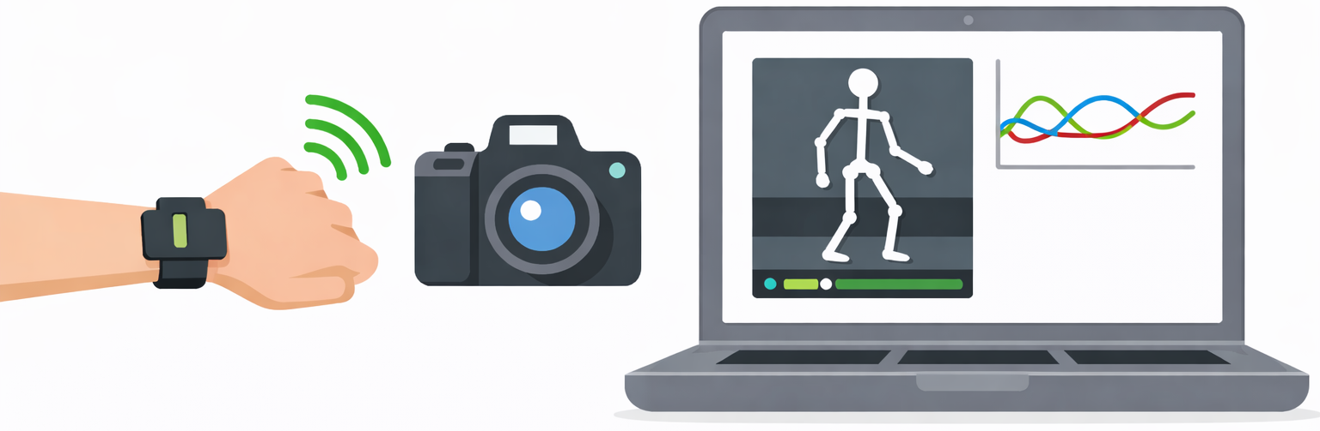
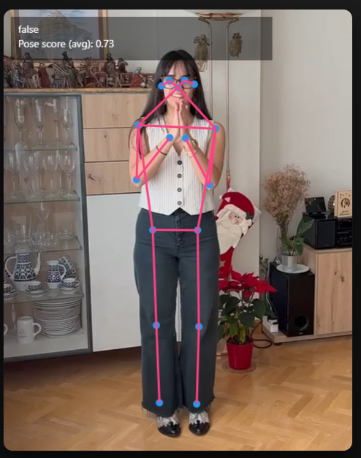
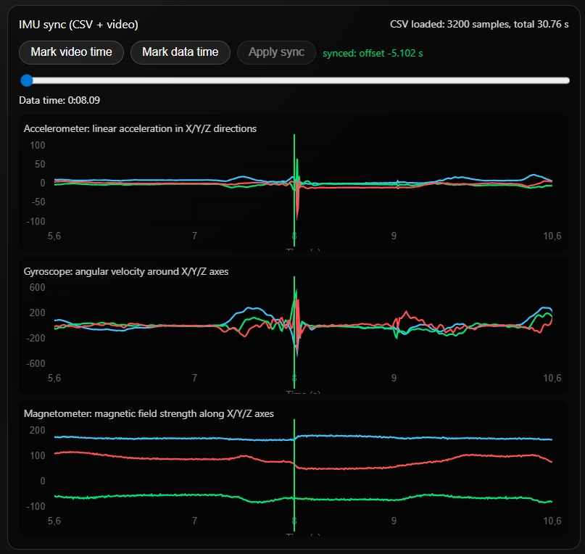
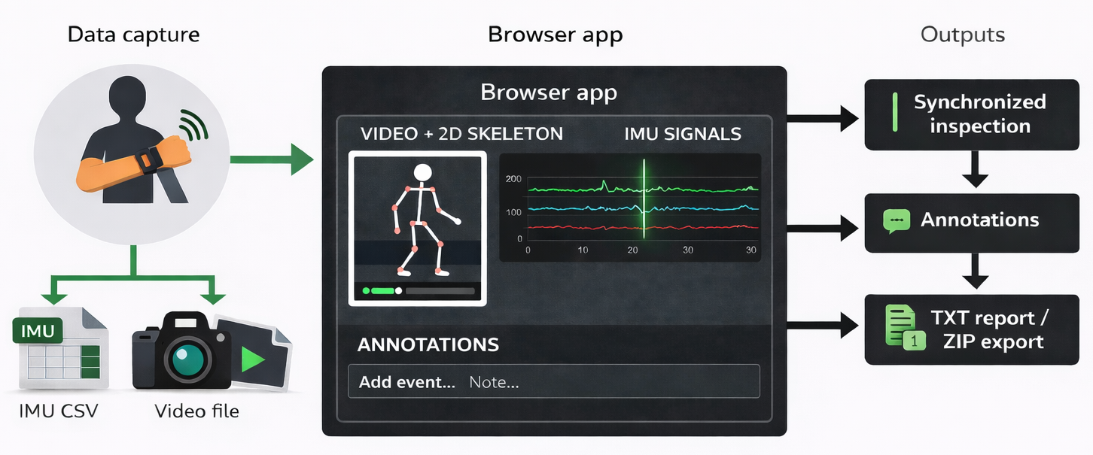
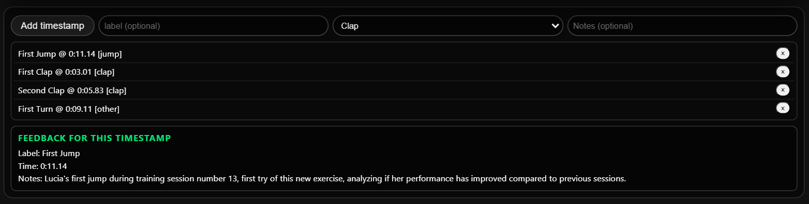
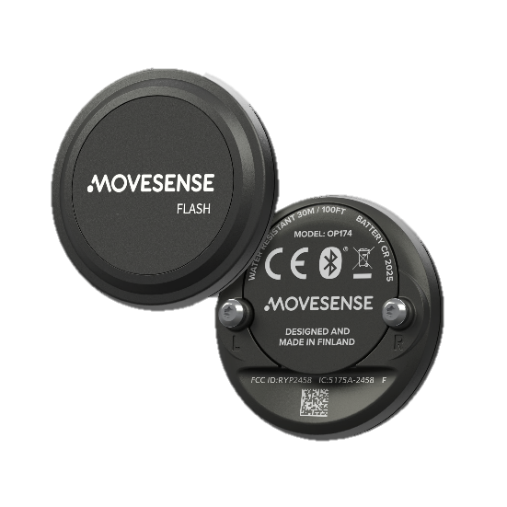
A Low-Cost and Low-Complexity Motion Sensor System Using IMU and Video-Based Tracking
Jack Hutton¹ Alexander Jonsson² Lisa Kanehl³ Sahand Khodabandehloo⁴ Lucía Pérez Sáez⁵
¹ ² ³ ⁴ ⁵ MSc Medical Engineering, KTH
INTRODUCTION
RESULTS AND DISCUSSION
Motion tracking challenge Motion tracking is important in healthcare, sports, and rehabilitation, but high‑end systems are expensive and lab‑bound
Our approach: Develop a low-cost, browser-based solution combining:
IMU sensor data (accelerometer, gyroscope, magnetometer)
Video-based 2D pose estimation
Event-based synchronization
Developed fully functional, low-cost browser-based IMU+video motion analysis prototype with stable event synchronization (Δt) across test workflows and reproducible ZIP/TXT exports.
Limitations:
2D pose estimation highly sensitive to occlusions, limited to single-person analysis
Manual synchronization lacks drift correction mechanisms
Exploratory research prototype, not suitable for clinical deployment
​
Future Work:
Sensor fusion implementation using Kalman filtering
Automatic synchronization through clap detection algorithms
Quantitative validation against established ground truth references
​
MATERIALS AND METHODS
Movesense HR2 provides tri-axial accelerometer, gyroscope, and magnetometer signals.
Initial CSV logging used Python app, later migrated to browser-based workflow (HTML/JS + Chart.js). The CSV parsing reconstructs timestamps from sample index using fixed 104 Hz rate.
​
IMU SUBSYSTEM
Single-person 2D pose estimation is performed using MoveNet Thunder (for uploaded videos) via TensorFlow.js.
MoveNet processing includes frame skipping (N = 2), reduced playback speed (v = 0.75×), and keypoint filtering (c ≥ 0.2).
These optimizations ensure stable performance on consumer hardware during synchronized motion analysis.
VIDEO SUBSYSTEM
Event-based synchronization provides precise temporal alignment between IMU signals and video footage.
Users manually identify matching reference events (e.g., claps, jumps) across both modalities.
The system computes a constant time offset Δt = t_video − t_IMU from these markers.
This offset automatically synchronizes timelines during video playback and scrubbing for coherent motion analysis.
SYNCHRONIZATION
Reproducible analysis:
localStorage automatically saves sync offsets and annotations {time, label, notes} per video.
ZIP export/import includes metadata + video/CSV files for complete project portability.
TXT reports summarize IMU timeline + stored annotations.
SESSION MANAGEMENT
OBJECTIVES
Objective: Design a low‑cost, low‑complexity motion tracking prototype that runs in a standard web browser.​
Aim: Enable synchronized visual inspection of video‑based pose estimation and IMU sensor data without specialized motion‑capture hardware.​

Slide 2
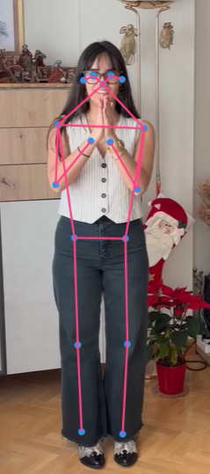
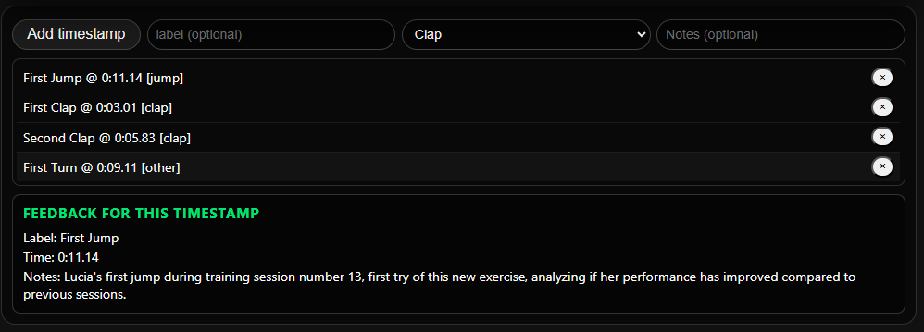
A Low-Cost and Low-Complexity Motion Sensor System Using IMU and Video-Based Tracking
Jack Hutton¹ Alexander Jonsson² Lisa Kanehl³ Sahand Khodabandehloo⁴ Lucía Pérez Sáez⁵
¹ ² ³ ⁴ ⁵ MSc Medical Engineering, KTH
INTRODUCTION
RESULTS AND DISCUSSION
Motion tracking challenge Motion tracking is important in healthcare, sports, and rehabilitation, but high‑end systems are expensive and lab‑bound
Our approach: Develop a low-cost, browser-based solution combining:
IMU sensor data (accelerometer, gyroscope, magnetometer)
Video-based 2D pose estimation
Event-based synchronization
Developed fully functional, low-cost browser-based IMU+video motion analysis prototype with stable event synchronization (Δt) across test workflows and reproducible ZIP/TXT exports.
Limitations:
2D pose estimation highly sensitive to occlusions, limited to single-person analysis
Manual synchronization lacks drift correction mechanisms
Exploratory research prototype, not suitable for clinical deployment
Future Work:
Sensor fusion implementation using Kalman filtering
Automatic synchronization through clap detection algorithms
Quantitative validation against established ground truth references
​
MATERIALS AND METHODS
Movesense HR2 provides tri-axial accelerometer, gyroscope, and magnetometer signals.
Initial CSV logging used Python app, later migrated to browser-based workflow (HTML/JS + Chart.js). The CSV parsing reconstructs timestamps from sample index using fixed 104 Hz rate.
​
IMU SUBSYSTEM
Single-person 2D pose estimation is performed using MoveNet Thunder (for uploaded videos) via TensorFlow.js.
MoveNet processing includes frame skipping (N = 2), reduced playback speed (v = 0.75×), and keypoint filtering (c ≥ 0.2).
These optimizations ensure stable performance on consumer hardware during synchronized motion analysis.
VIDEO SUBSYSTEM
Event-based synchronization provides precise temporal alignment between IMU signals and video footage.
Users manually identify matching reference events (e.g., claps, jumps) across both modalities.
The system computes a constant time offset Δt = t_video − t_IMU from these markers.
This offset automatically synchronizes timelines during video playback and scrubbing for coherent motion analysis.
SYNCHRONIZATION
Reproducible analysis:
localStorage automatically saves sync offsets and annotations {time, label, notes} per video.
ZIP export/import includes metadata + video/CSV files for complete project portability.
TXT reports summarize IMU timeline + stored annotations.
SESSION MANAGEMENT
OBJECTIVES
Objective: Design a low‑cost, low‑complexity motion tracking prototype that runs in a standard web browser.​
Aim: Enable synchronized visual inspection of video‑based pose estimation and IMU sensor data without specialized motion‑capture hardware.​

Slide 3
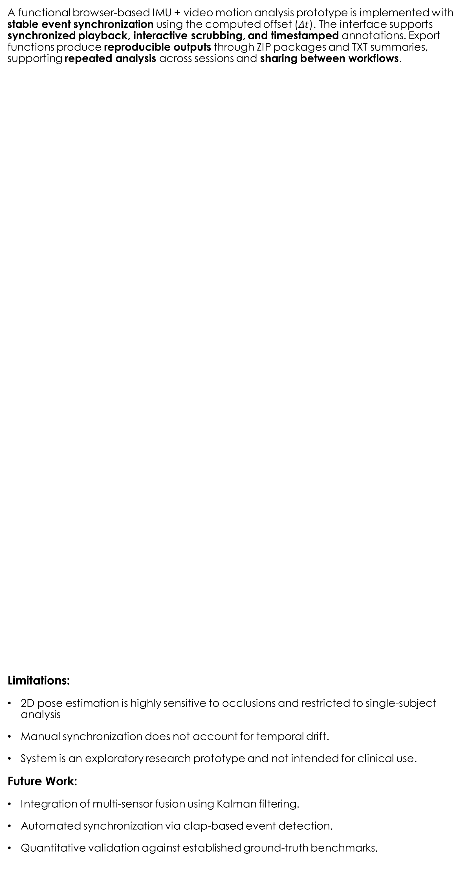
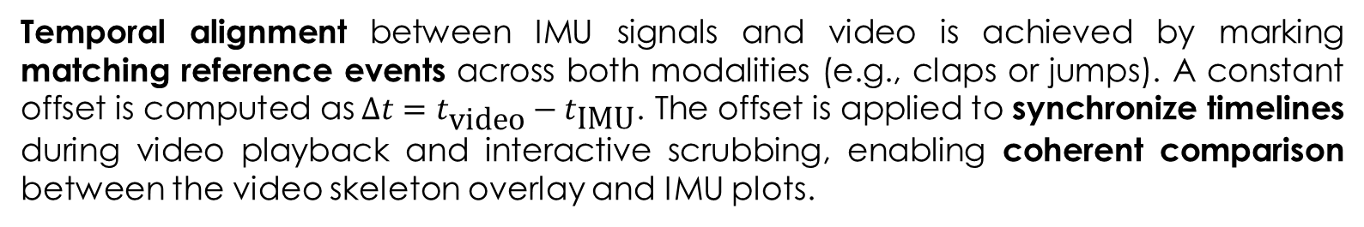
A Low-Cost and Low-Complexity Motion Sensor System Using IMU and Video-Based Tracking
Jack Hutton¹ Alexander Jonsson² Lisa Kanehl³ Sahand Khodabandehloo⁴ Lucía Pérez Sáez⁵
¹ ² ³ ⁴ ⁵ MSc Medical Engineering, KTH
INTRODUCTION
OBJECTIVES
Motion tracking is widely used in healthcare, sports, and rehabilitation, but many high-end systems remain expensive and require controlled laboratory setups. A browser-based workflow can reduce cost and setup complexity while maintaining practical utility for inspection and analysis. The presented system combines inertial measurement unit (IMU) signals (accelerometer, gyroscope, magnetometer) with video-based 2D pose estimation and event-based synchronization to align both modalities in time.
Objective: Design a low‑cost, low‑complexity motion tracking prototype that runs in a standard web browser.​
Aim: Enable synchronized visual inspection of video‑based pose estimation and IMU sensor data without specialized motion‑capture hardware.​
RESULTS AND DISCUSSION
A functional browser-based IMU + video motion analysis prototype is implemented with stable event synchronization using the computed offset ($Δt$). The interface supports synchronized playback, interactive scrubbing, and timestamped annotations. Export functions produce reproducible outputs through ZIP packages and TXT summaries, supporting repeated analysis across sessions and sharing between workflows.
Limitations:
2D pose estimation is highly sensitive to occlusions and restricted to single-subject analysis
Manual synchronization does not account for temporal drift.
System is an exploratory research prototype and not intended for clinical use.
Future Work:
​Integration of multi-sensor fusion using Kalman filtering.
Automated synchronization via clap-based event detection.
Quantitative validation against established ground-truth benchmarks.
MATERIALS AND METHODS
SYSTEM OVERVIEW
Data are collected using an IMU device and a standard video recording. A browser application loads the video and IMU CSV data, performs pose estimation, visualizes signals, supports event annotation, and exports results for reproducible analysis.
IMU SUBSYSTEM
Movesense HR2 is used to capture tri-axial accelerometer, gyroscope, and magnetometer signals. Data logging was initially implemented in a Python workflow and later migrated to a browser-based pipeline (HTML/JS with Chart.js). Timestamps are reconstructed from the sample index using a fixed sampling rate of 104 Hz.
VIDEO SUBSYSTEM
Single-person 2D pose estimation is performed using MoveNet Thunder executed in TensorFlow.js for uploaded videos. To maintain stable performance on consumer hardware, the pipeline applies frame skipping (N = 2), reduced playback speed (v = 0.75×), and keypoint filtering (confidence c ≥ 0.2). These measures support responsive synchronized inspection during playback and scrubbing.
SYNCHRONIZATION
Temporal alignment between IMU signals and video is achieved by marking matching reference events across both modalities (e.g., claps or jumps). A constant offset is computed as$Δt=t_{\text{video}}−t_{\text{IMU}}$. The offset is applied to synchronize timelines during video playback and interactive scrubbing, enabling coherent comparison between the video skeleton overlay and IMU plots.
REPRODUCIBILITY
Synchronization offsets and annotations (time, label, notes) are stored locally in the browser (localStorage) to support repeatable workflows. ZIP export/import packages metadata together with video/CSV files to reproduce a complete project state. TXT reports summarize the IMU timeline alongside stored annotations.
ACKNOWLEDGEMENTS
CONCLUSION
Sincere thanks to Jonas Willén, lecturer and program director of MSc in Sports Technology, for supervision, guidance, and helpful feedback throughout the project.
A low-cost, browser-based IMU and video motion tracking system was implemented and shown to be feasible. The prototype supports synchronized inspection and reproducible exports, demonstrating practical potential for low-complexity motion analysis workflows.

